Slide 1



eduAv: Front-End Prototype
After making a selections in the Python program, please build your personalised eduAv !

Slide 2



Skin Tone Choices [1/1]:

Slide 3





Eye Choices [1/1]:

Slide 4



Mouth Choices [1/1]:

Slide 5



Nose Choices [1/1]:

Slide 6

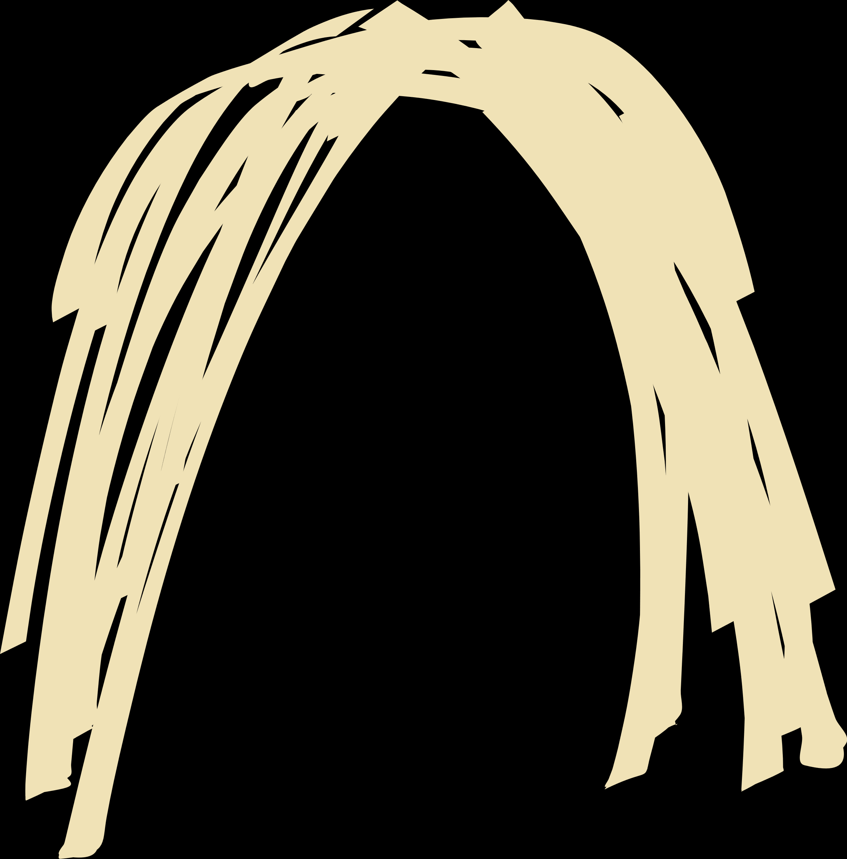
Hair Choices [1/3]:

Slide 7


Hair Choices [2/3]:

Slide 8


Hair Choices [3/3]:

Slide 9
STOP! NEXT SLIDE ARE OTHER PEOPLE’S CREATED eduAVS

Slide 10
Age: 22
Gender: M
Likeness Rating: 7/10
Age: 20
Gender: M
Likeness Rating: 5/10
Age:
Gender:
Likeness Rating: ?/10
Age:
Gender:
Likeness Rating: ?/10
Age:
Gender:
Likeness Rating: ?/10
Age:
Gender:
Likeness Rating: ?/10
Age:
Gender:
Likeness Rating: ?/10
Age:
Gender:
Likeness Rating: ?/10

